Slide 1
Voice Recognition
Team Members
1.Deepak.G
2. Karthik Raja.M
3.Arun Kumar.S
Facultyguide : Industrial guide :
Mr.Suresh Kumar Mrs.Gokula vani
Assistant professor Designation
Department of CSE
Department of CSE, KGiSL Institute of Technology, Coimbatore

Slide 2
Abstract
Speech recognition is a kind of technology that is using computer to transfer the voice signal to an associated text and extract the important key phrases.
We done it through python script. There are several APIs available to convert speech to text in python.
One of such APIs is the Google speech to text API commonly known as the speech recognition API. This requires an active internet connection to work. However, there are certain offline Recognition systems such as PocketSphinx.
After converting speech to text we extract the key phrases from the speech through the NLP approach .After extracting we display it on screen like a notepad or word document etc.

Slide 3
Area Introduction-Existing system
X-lite: It is an application powered by Counter path
Siri Technology: It is an application used by the company Apple in their iPhones.
Google Assistant: It is an application used by the google in their Android phones.

Slide 4
Proposed System
A speech to text converter using NLP (Natural language processing).
Not only converts text to speech but also has the ability to extract the useful information from the converted speech.
Using sophisticated algorithms like RAKE and Text rank algorithm to extract the keywords.
Advanced models may also be able to process colloquial audio input.
Department of CSE, KGiSL Institute of Technology, Coimbatore

Slide 5
Literature Review
Drawbacks of existing methods:
Does not deliver the key points, this means that the existing system only does the simple job of converting text to speech.
Does not have the ability to process short messages or inputs. This means that the old conventional methods are only designed to get text output from a complete well constructed sentence.
Lack of tone and emotion.
References:
X-lite: www.counterpath.com/x-lite/
Speechnotes: www.speechnotes.co/
Department of CSE, KGiSL Institute of Technology, Coimbatore

Slide 6
Module Splitup
Module 1 : Speech to Text
Module 2 : NLP (Natural language processing)
Module 3 : NLP pattern recognition
Module 4 : Keyword Extraction
Module 5 : Indexing Keyword

Slide 7
Flow chart
Audio File
Python Script
Speech to Text
Keyword Extraction

Slide 8
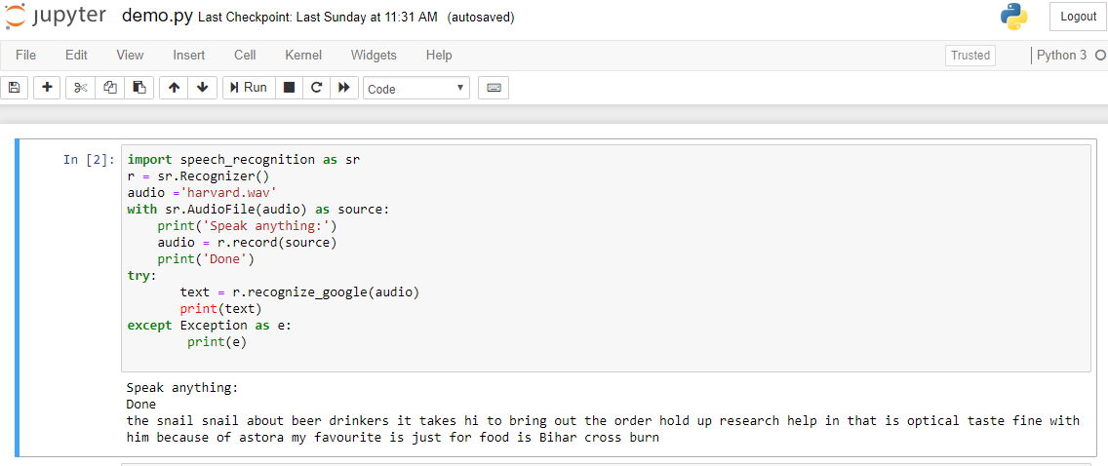
Screen shots of modules under progress.
Department of CSE, KGiSL Institute of Technology, Coimbatore

Slide 9
Thank You
Department of CSE, KGiSL Institute of Technology, Coimbatore

